Slide 1


In this session you will:
Understand why stakeholder mapping matters
Amplify: Regional voices in practice
Try the template in breakout groups
Share reflections
Seminar: Stakeholder mapping with young people

Slide 2
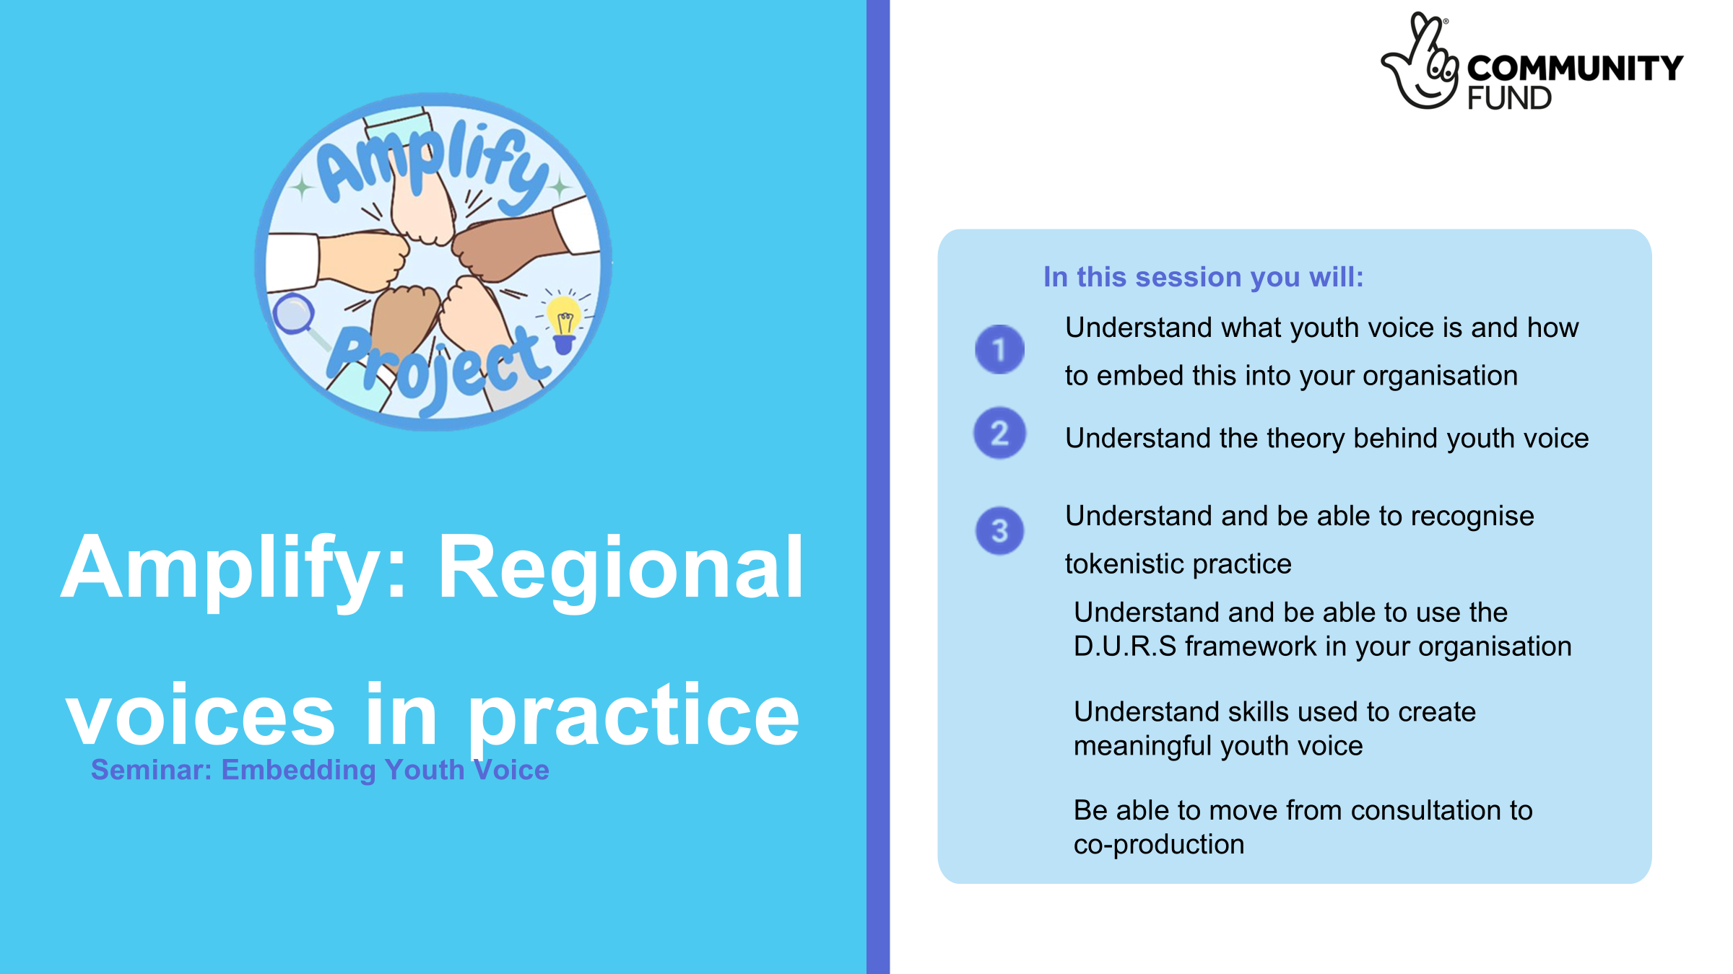


Slide 3

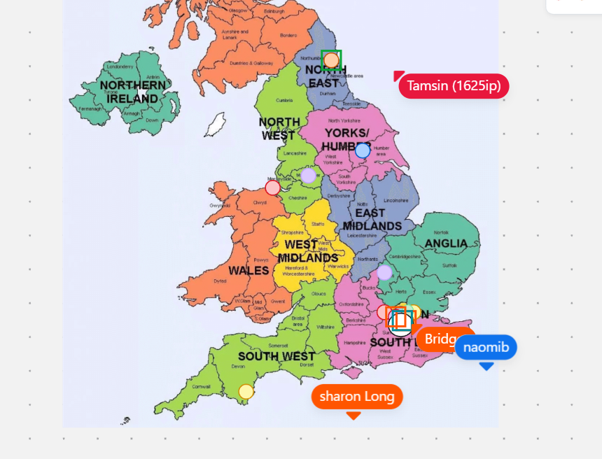
Who is in the room with us?

Slide 4
About Amplify
This project aims to build an inclusive and equitable approach to youth voice and youth engagement.
The project has a particular focus on ensuring the most marginalised and under-represented young people have their voices heard and acted upon across the nine English regions.
Through Amplify, we will build a consistent approach, increasing the impact on services designed with, and, for young people.
Year 1 has looked at youth voice in 4 main regions: London, the North East, the South West and Yorkshire and Humber.
Amplify uses a peer research model, which means 16 young people have been trained to be research experts across the year. They have made key decisions from how the data is collated, who is involved and what outputs will be used
Peer researchers have designed a series of resources and trainings based on Year 1 findings

Slide 5
What is stakeholder mapping?
Key questions stakeholder mapping helps us answer:
Definition:
Stakeholder mapping is a structured way of
  Identifying
  Categorising
  Understanding
In this case, we are looking at grouping the key people and organisations that can influence or be affected by your project.
  Who has the power to make change happen?
  Who care the most about the outcome?
  Who do we need on our side?

Slide 6



Why is stakeholder mapping important
Feeling unheard
Power & influence
More impact
We hear from young people repeatdly that even after taking part in opportunities, they often feel unheard in decisions that affect them.
A lot of the times, we might not know where power and influence actually sits. Knowing who has what power can make it easier to feel heard and lead to action.
Having mapped out stakeholders, we can be more deliberate about our engagement. Having continous engagement can lead to stronger relationshios and greater impact.
Stakeholder mapping

Slide 7
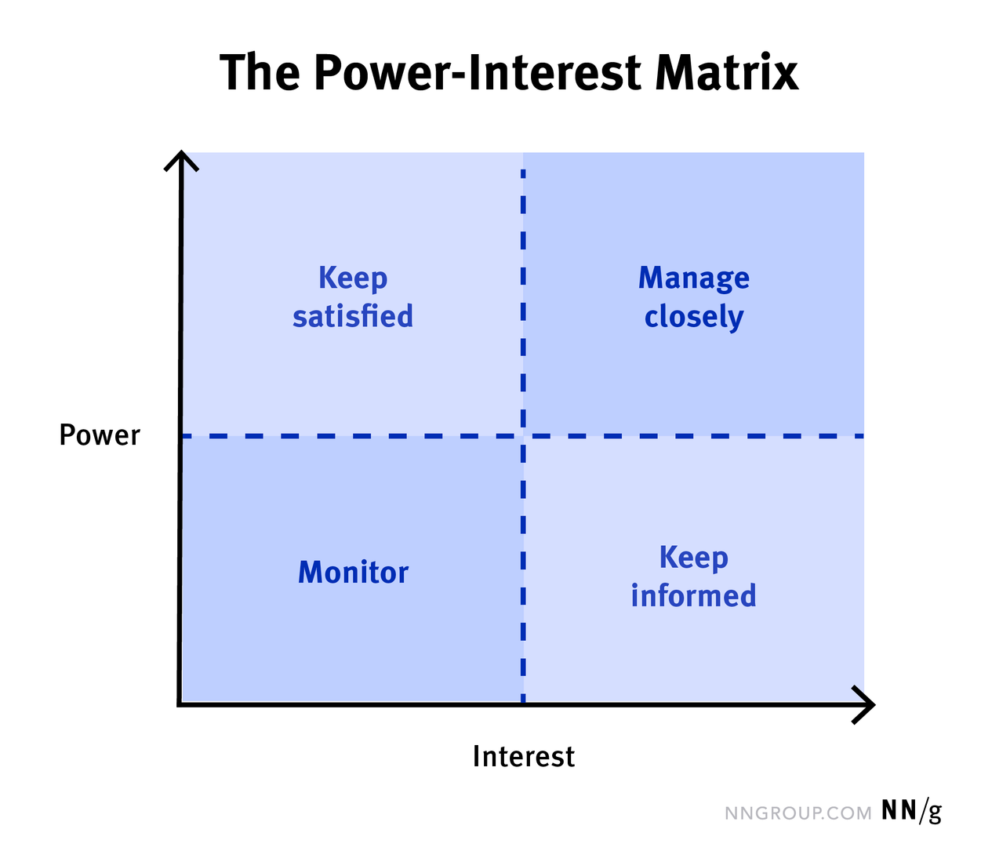
Stakeholder mapping approaches
Power-Interest Matrix
The most common way of approaching stakeholder mapping is by creating a power-interest matrix for your project.
This maps stakeholders by how much control they have (power) vs. how much they care (interest).
Great for deciding engagement strategies based on where they are situated in the map.
Example
A friend might have more interest in your initative to start a new after school club vs your Headteacher has more power over your after school club

Slide 8
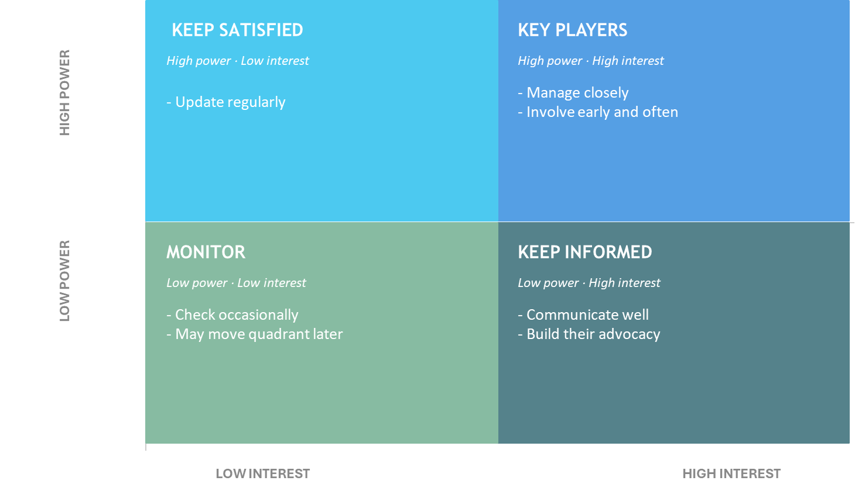
Power-Interest Matrix

Slide 9
Power- Interest matrix
High power + Low interest = Keep satisfied
High power + High interest = Key players
Low power + Low interest = Monitor
Low power + High interest = Keep informed
They have big influence but might not be as invested in your work yet. They can block or enable your project, even if they’re not directly involved
How to work with them: Keep them updated, give them just enough info to keep them supportive.
Examples: Policy makers, CEOs
These people can influence your project a lotand they care about it. They are your most important stakeholders.
How to work with them: Keep them close, involve them in decisions, update them often.
Example: Funder, partner organisation
They’re not very influential and not very interested.
They’re not a priority, but still worth keeping an eye on.
How to work with them: Minimal communication, just check in occasionally.
Examples: People indirectly impacted
They care a lot, but they don’t have much influence. They’re often your biggest supporters, volunteers, or users.
How to work with them: Keep them updated, involve them, let them feel ownership.
Examples: Volunteers, other organisations

Slide 10
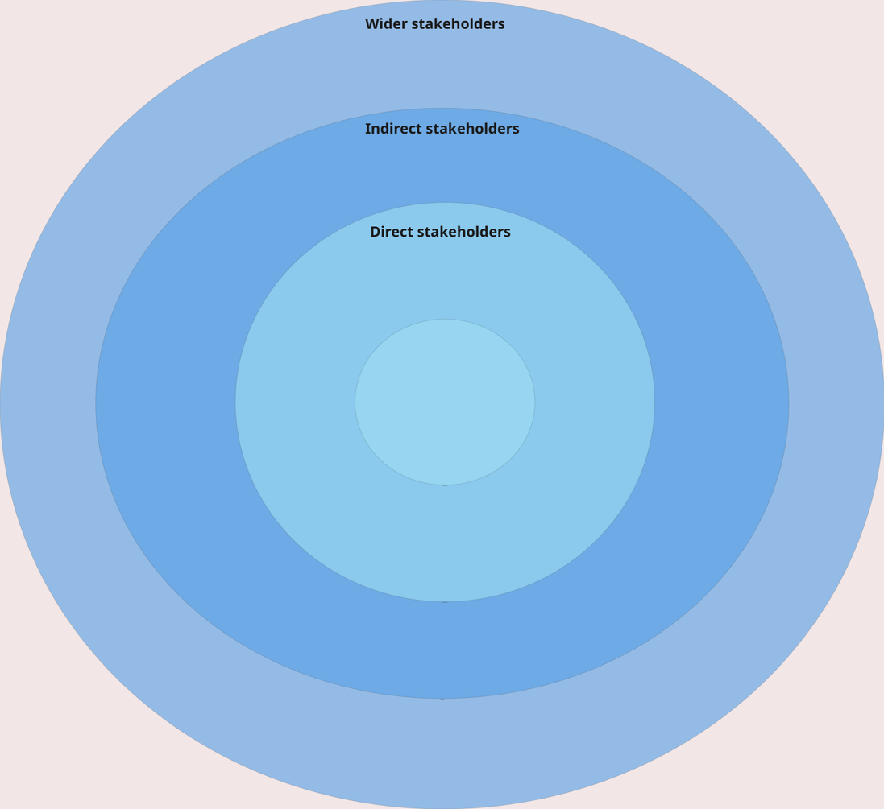
Stakeholder rings
Another way to approach stakeholder mapping is to think about the different levels of impact
Direct stakeholders- inner circle:
Essential stakeholders: Those who must be involved
Indirect stakeholders- middle ring:
Involved but not essential to the core event
Wider stakeholders- outer ring:
Might be slightly affected by or interested in what you're doing

Slide 11
How to approach mapping
Ask yourself: Who is in my network?
The first step:
Everyone has a network. Most people just don't map it.
Stakeholder mapping makes your existing connections visible and useful. Your network is a good starting point for mapping.
  Who might they know that you might not?
  How close are you to a decision-maker?
Keep this in mind as we do our next activity

Slide 12
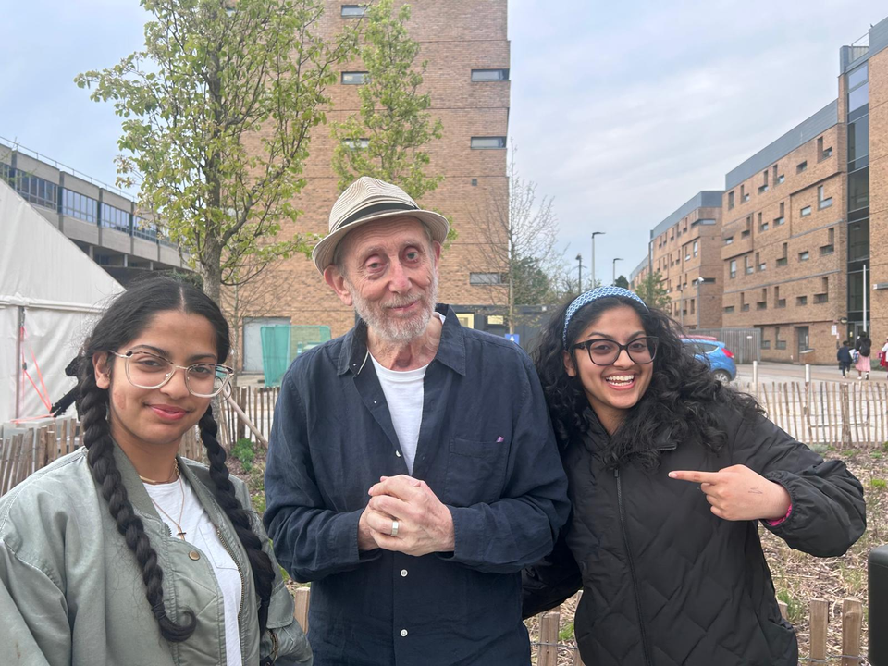

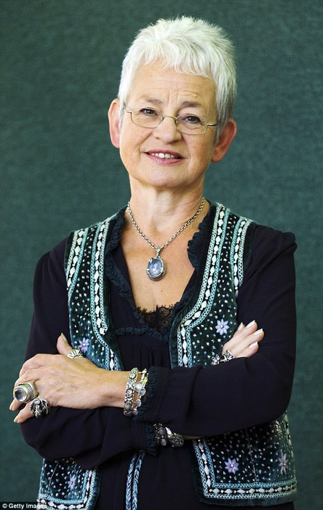

Six degrees of seperation
Example: Angel can get to Jacqueline Wilson
Hint: She met Michael Rosen

Slide 13




Now it's your turn
Can you think of how you are connected to these figures?

Slide 14
From 6 degrees to stakeholder mapping
How did you find that activity?
Notice how thinking about connections forced you to consider who you know, who they know, and how those relationships could be used purposefully.

Slide 15
Amplify: Regional voices in practice
Template talk through

Slide 16
Stakeholder mapping template
Let’s go to Miro and introduce the template. This Miro template uses a dream holiday metaphor to help young people practise the skill of stakeholder mapping in a fun and relatable way. Key activites include:
The 5 W’s:
Build your dream holiday using who, what, where, when and how.
Identify stakeholders:
Place stakeholders in the ring based on their role.
Stakeholder matrix:
Plot stakeholders by power and interest.
Transfer it over:
Reflect on holiday skills and apply to your real project by completing a full stakeholder map,
Outreach:
Planning what are the next steps after mapping out key stakeholders

Slide 17


Where can we find the template
Miro template
You can find this template on Miro under the name ‘Amplify stakeholder mapping’,
PDF and other assets
PDF versions of the activites and all ther accompanying assets can also be found on our website

Slide 18
Now you will:
Work through the template together as a group.
Breakout rooms
Share reflections

Slide 19

Feedback
Time to put your knowledge to the test!
We have created a Kahoot to measure distance travelled! You can use this with your young people but we would like to test it now
We would love to hear from you:
  What worked well?
  What were any challenges faced?
  How could you use this with young people?
Evaluation forms will be shared in the chat, please take 2 minutes to complete. Thank you!
Notes:
Click icon to open kahoot page - login needed

Slide 20

Thank you to our partners
Notes:
Thank you to all our partners who are a part of the Regional Youth Units
and Thank you to our Funder the National Lotteries Community Fund.

