Slide 1
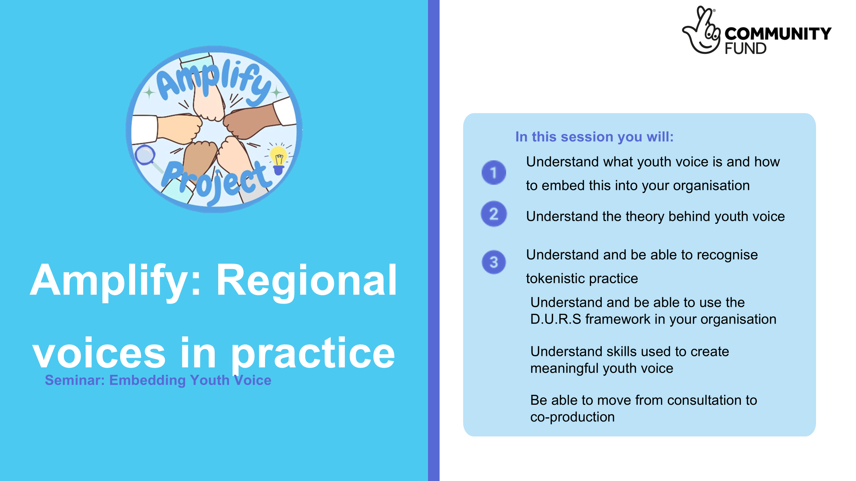
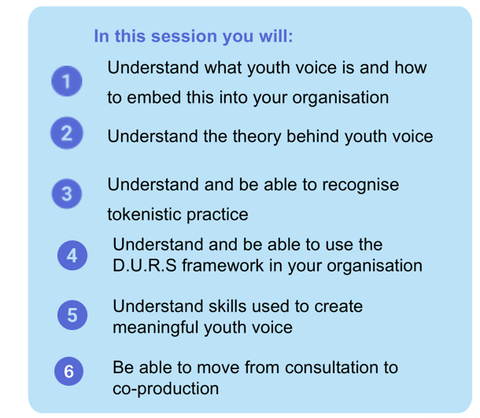
Notes:
Jess

Slide 2

About Amplify
This project aims to build an inclusive and equitable approach to youth voice and youth engagement.
The project has a particular focus on ensuring the most marginalised and under-represented young people have their voices heard and acted upon across the nine English regions.
Through Amplify, we will build a consistent approach, increasing the impact on services designed with, and, for young people.
Year 1 has looked at youth voice in 4 main regions: London, the North East, the South West and Yorkshire and Humber.
Amplify uses a peer research model, which means 16 young people have been trained to be research experts across the year. They have made key decisions from how the data is collated, who is involved and what outputs will be used
Peer researchers have designed this training based off previous research findings and a toolkit which was created.
Notes:
Jess

Slide 3


What does Youth Voice actually mean?
“Young People have real influence - not just being heard, but helping design, shape, and lead change in projects, decisions, and organisations, as well as being able to see tangible impact of their involvement”
“Youth voice is a broad term for a wide range of different activities that provide young people with the opportunity to meaningfully contribute to and influence decisions which impact them and their community”
“Youth voice is the distinct ideas, opinions, attitudes, knowledge, and actions of Young People as a collective body. It is about ensuring that young people are not only heard, but actively engaging in shaping decisions and policies that impact their lives, their communities, and the world”
Notes:
Ava
As you can see on the screen, there are many varying definitions of youth voice. All definitions include the same underlying meaning. This is that effective youth voice practice means listening to young people, valuing their ideas and giving them meaningful opportunities to be involved in decisions that affect them.
At Amplify, we define youth voice as young people have real influence, not just being heard, but helping design, shape, and lead change in projects, decisions, and organisations, as well as being able to see tangible impact of their involvement.

Slide 4

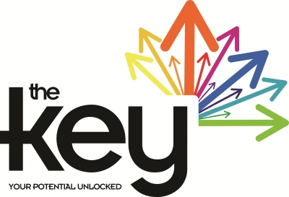

Examples of good youth voice
Peer Action Collective
The Key
All Child
Peer Research project which aims to understand what is needed to help young people live a life free from violence and put what is learnt into action.
The Key supports and funds young people to develop and create projects that are important to them.
Supports communities across the UK to help children and young people build the social, emotional and academic skills they need to flourish.
Notes:
Ava
Listed here is a few examples of organisations and projects that have effectively implemented youth voice. I’m going to be briefly touching on each and hopefully they can give you all a better understanding of what good practice looks like.
Peer Action Collective (PAC) - This project looked at youth violence across the United Kingdom. This is a strong example of good youth voice as young people were involved at every stage of the project. This was a peer research project which aims to understand what is needed to help young people live a life free from violence and put what is learnt into action. Young people hired as Peer Researchers interviewed and listened to other young people, helping to make sure experiences were understood from a genuine perspective. PAC placed young people at the centre of their work, with young people carrying out research, writing reports, making recommendations, and helping deliver real social action and change.
The Key is another good example because they support and fund young people to create and develop projects that matter to them personally and an opportunity to turn their ideas into reality. This gives the young people ownership and responsibility over their project.
The All-Child research project also showed good youth voice by involving a wide range of young people from different schools and backgrounds. The project focused on topics that young people themselves identified as important, and they were involved throughout the interviews and evaluation process.

Slide 5
Theory of Young People’s Participation
Roger Hart’s Ladder of Young People’s Participation
Sociologist Roger Hart wrote ‘Children's Participation: The Theory and Practice of Involving Young Citizens in Community Development and Environmental Care’ for UNICEF in 1997.
‘Ladder of Youth Participation’ is one of the many significant tools created from this book.
Notes:
Ava
We are now going to quickly look at a prominent theory behind young people’s participation which we thought would be helpful in enhancing everyone’s understanding.
In 1997, sociologist Roger Hart wrote a book for UNICEF called Children’s Participation. Overtime, it has rightfully become a keystone text in youth work because it explores how young people can be meaningfully involved in decision-making and community projects, while also recognising the role adults play in supporting that participation.
One of the most well-known ideas from the book is the “Ladder of Children’s Participation”, also known as the “Ladder of Youth Participation”. This model is still widely used today as a way of understanding different levels of participation and how much influence young people have within projects and decisions.

Slide 6
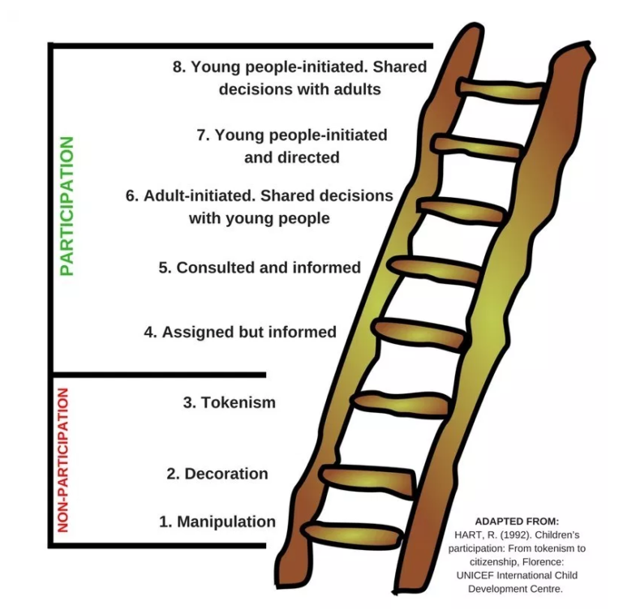
Ladder of Young People’s Participation
Notes:
Ava
Roger Hart’s theory is presented as a metaphorical ladder, which each ascending rung representing increasing levels of child agency, control or power. The ladder begins at nonparticipation to degrees of participation.
At the top of the ladder model is Rung 8: Young people initiated, shared decisions with adults. This is where young people start the project themselves but they will share decisions with adults along the way. It’s a real partnership where young people lead the way but still get support and guidance from adults when needed.
Rung 7: Young people initiated and directed is when young people fully lead the project themselves. Adults might be involved, but only in the background to support. This is often seen in youth-led activism.
Rung 6: Adult initiated, shared decisions with young people is when adults start the project, but the decision-making is shared with the young people. For example, participatory action research fits here.
Rung 5: Consulted and informed is when adults run the project, but they ask young people for their views and take them seriously. Young people are told how their input will be used and the outcomes of the decisions which were made by adults. Youth advisory groups often sit at this level.
Level 4: Assigned but informed is when young people are given a specific role and are clearly told what is expected from them and why they’re involved.

Slide 7
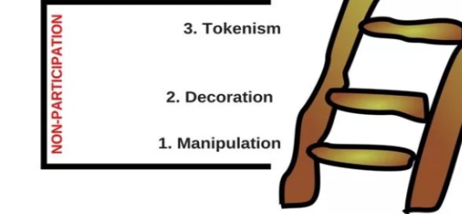
Ladder of Young People’s Participation
Non-Participation
Tokenism - Young People appear to be given a voice, but in fact they have little or no choice about what they do or how they participate.
Decoration - Young People are used to help or ‘bolster’ a cause in an indirect way, adults do not pretend the cause is inspired by young people.
Manipulation - Adults use young people to support causes and pretend that the causes are inspired by young people.
Notes:
Ava
On this slide, we are going to look at the non-participation levels of the ladder: Levels 1 to 3. These are situations where young people are involved in ways that don’t really give them any meaningful influence.
Rung 3 - Tokenism is when young people appear to have a voice, but in reality they have little or no real choice over what they do or how they take part.
Rung 2 - Decoration is when young people are used to support or “boost” a cause in a visible way, but they’re not actually involved in shaping it. Adults don’t usually pretend the idea came from young people, they’re more there for appearance or promotion.
Rung 1 - Manipulation is the lowest level, where adults use young people to support a message or project, but make it seem like it was created or led by young people when it wasn’t.
Before we move on, I’d like to do a quick show of hands or thumbs up, how many of you have seen tokenistic youth voice in practice before in your profession?
It’s often more common than we realise.

Slide 8
Non-Participation Activity
Case study -
A local authority launches a new youth initiative. They invite a group of young people to attend the launch event. The young people are given branded t-shirts and banners to hold. They stand on stage and in the background of photos.
The young people were not involved in planning the project and they were not able to speak or contribute at the launch event.
Is this an example of -
Tokenism, Manipulation or Decoration?
Notes:
Jess

Slide 9
Non-Participation Activity
Case study -
A youth organisation is trying to secure funding for a new community centre. Staff ask a group of young people to appear in a campaign video, staff write the young people a script to read off. Staff say things to the young people like “this centre will change our lives”. The young people didn’t help design the project and they don’t really understand what it is about.
Is this an example of -
Tokenism, Manipulation or Decoration?
Notes:
Jess

Slide 10
Non-Participation Activity
Case study -
A youth service is redesigning it’s after-school programme. Staff organise a ‘youth consultation’ session. The young people share their ideas about the activities they want, the timing of the session and the support they need. Staff thank them and say that their views are important. The final programme is decided entirely by adults, with little or none of the young people’s suggestions used.
Is this an example of -
Tokenism, Manipulation or Decoration?
Notes:
Jess

Slide 11

Tokenistic Practice
Tokenism is defined as doing something only because you have to, to show you are following the rules, and not because you really believe it is the right thing to do.
It is the practice of including a member from an underrepresented community to create the appearance of inclusion, inclusive practices, or acceptance without making the individual has meaningful support and opportunities.
Notes:
Ava
We are now going to take a deeper look into tokenism and how to avoid it.
Tokenism is when something is done out of obligation rather than because there is a genuine belief in it or commitment to it. It can become a way of showing you are doing the right thing without real change behind it.
It often looks like including someone from an underrepresented group to give the appearance of inclusion or diversity, but without giving them real support, influence, or meaningful opportunities to take part or make decisions.

Slide 12
Tokenistic Practice - How to Avoid?
A
Ask early (involve young people at the start, not when decisions are already made)
C
Create real choices (give young people genuine decision-making power, not just opportunities to give opinions)
T
Tell them the limits (Be honest about what they can and can’t influence like budgets, rules and safety)
I
Include everyone (make sure participation is diverse and accessible, not just the same voices)
O
Own the feedback loop (show clearly what changed, what didn’t and why)
N
Never ignore their voices (if young people speak, it should lead to action or explanation)
Notes:
Ava
On this slide, there's a simple acronym you can use to use when implementing youth voice. It can be a tool and a reminder that youth participation should lead to real change. All you have to remember is ACTION.
First, ask early. Involve young people from the beginning, not once decisions have already been made.
Next is create real choices. Young people should have genuine decision-making power not just an opportunity to give opinions.
Then, tell them the limits. Being honest about what they can and can’t influence builds trust and sets realistic expectations.
The ‘I’ stands for include everyone. Participation should be diverse and accessible to create a representative sample and to ensure you're not hearing from the same voices each time.
After that, Own the feedback loop. If young people contribute ideas, show them what changed, what didn't and most importantly explain why.
Finally, never ignore their voices. If young people take the time to share their perspective, their input should lead to action, discussion or at least a clear response.
So overall, ACTION is a simple way to check whether youth voice is being implemented meaningfully rather than tokenistically.

Slide 13
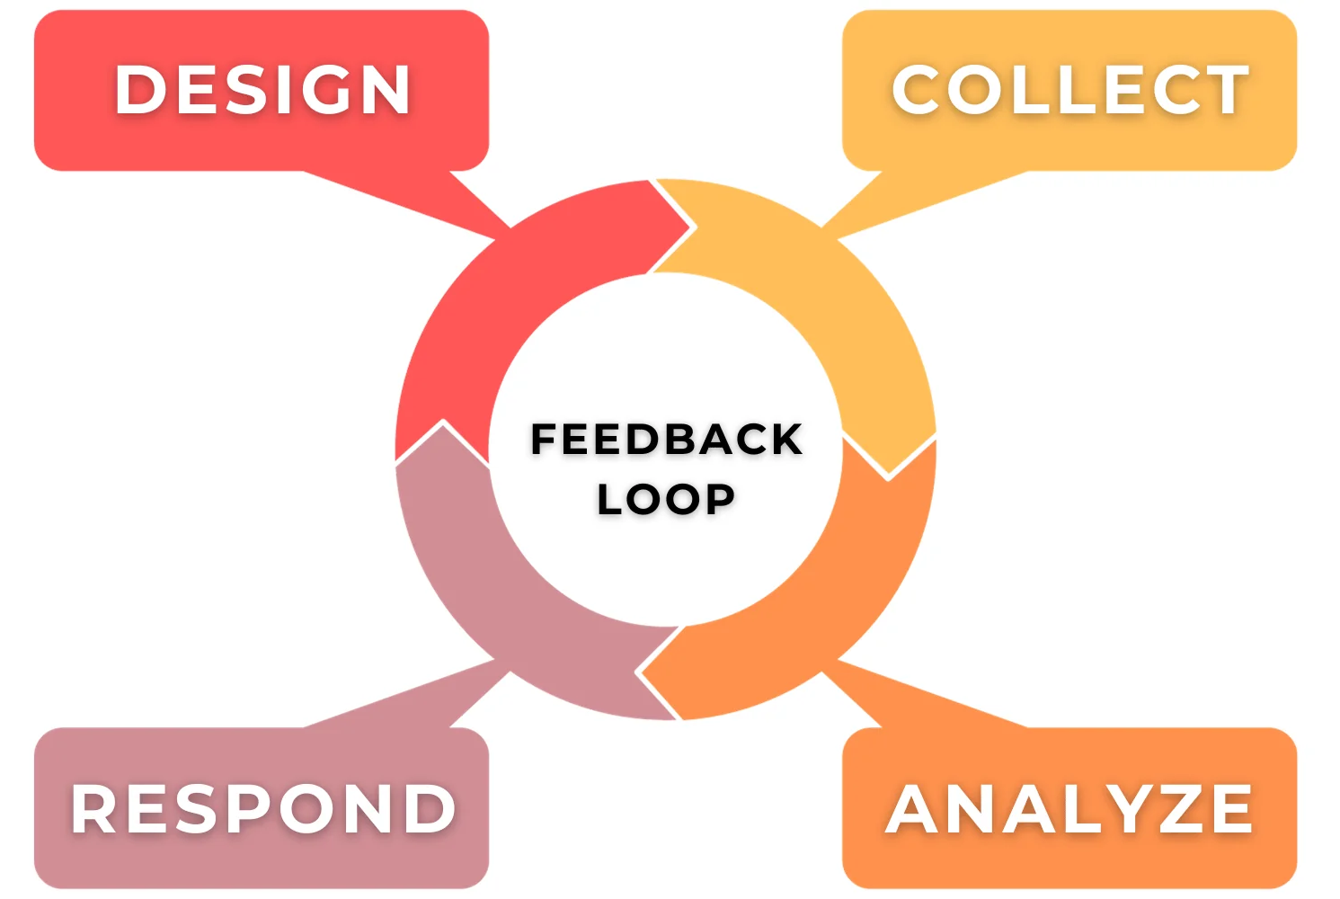
Tokenistic Practice - Feedback Loop
4
Could be the beginning of a new project where the young people could co-produce this with their ideas.
1
Collect the views of the young people:
Surveys
Consultations
Workshops
3
2
Look through the views given by the young people and use it to make decisions.
(Some of their views may match your companies aim or goals)
Sometimes you can decide to not go with the young people’s ideas and that is fine as long as you respond.
Go back to the group and tell them what has happened
What changed
What didn’t change
Why
Notes:
Ava
This slide focuses on the feedback loop and why its important in creating meaningful youth participation. A feedback loop makes sure young people don’t just share ideas and then never hear back about them. Instead, it creates an ongoing process of listening, acting, responding and hopefully designing.
The first stage is collect. This means gathering young people’s views in different ways, such as surveys, consultations or workshops. Using different methods helps make participation more accessible and allows more voices to be heard.
Next is analyse. Here we look at the feedback and use it to inform decisions. Sometimes the ideas shares may align with the organisation’s goals, and sometimes they may not. Either is okay. The important thing is that feedback is being genuinely considered.
The next stage is respond. This is where the young people involved are told what happened as a result of their input. This step is especially important because it shows transparency and accountability.
The final stage is design, this may not always be used.
This is where young people can help shape a project from the beginning and even co-produce their ideas alongside the organisation.
Ultimately, the feedback loop helps move youth voice beyond tokenism by making participation meaningful and action-focused.

Slide 14
Tokenistic Practice - Feedback Loop (Example)
A youth club asks the young people what activities they would like and what would make the youth club better for them.
The young people help the staff members plan the new sports session.
They pick the activities that will be taking place and what external organisations are coming in to teach them sports.
Staff from the youth club completed a consultation with the young people who attend and they said they want more sports and later opening times.
Staff go back to the group and tell the young people that they are going to begin setting up an additional sports session.
They explain to the young people that they couldn’t extend their opening hours due to staffing limits.
They explain that they will review this in the next quarter.
The staff took their opinions away and had a look to see if this was feasible.
Staff are looking to introduce weekly sports sessions but they cannot push the opening times back due to their budget and the opening hours of the centre they are based in.
Notes:
Ava
Here’s a quick overview of what a feedback loop can look like in practice, using a youth club as an example.
I’ll give you a few minutes to read through it, then we’ll move on together to make sure everyone feels comfortable with the concept. If anything isn’t clear, feel free to drop your questions in the chat.

Slide 15
Tokenistic Practice- how to avoid
Ask yourself these questions….
Who made the final decision?
If the people in charge of the project knew how this was being ran, would they be okay with it?
Did the young people have any real power?
When did we involve the young people in the project?
Were we open to changing plans based of what the young people said?
Did we involve only the confident young people?
Would I be prepared if young people shared feedback I didn’t want to hear?
Why did we involve young people?
Notes:
Ava
Finally, here are a few questions you can use to reflect on your existing work with youth voice. These are designed to help you think critically about practice and identify where tokenism may be happening. Feel free to take a photo of the slide.
Some of these questions include:
Was I prepared for young people to share feedback I might not have wanted to hear?
Did young people have real power in this process?
At what stage were young people involved, and how meaningful was that involvement?
These are just a few examples, but they are a useful starting point for reflection.
If you could not confident about your answer to these questions, or if you begin to think that the control has stayed with adults and involvement was too late, then it is likely that you are not using youth voice effectively and your work may be tokenistic.
If you regularly ask yourself these questions, you can catch it early and move your practice up the ladder into real participation.

Slide 16
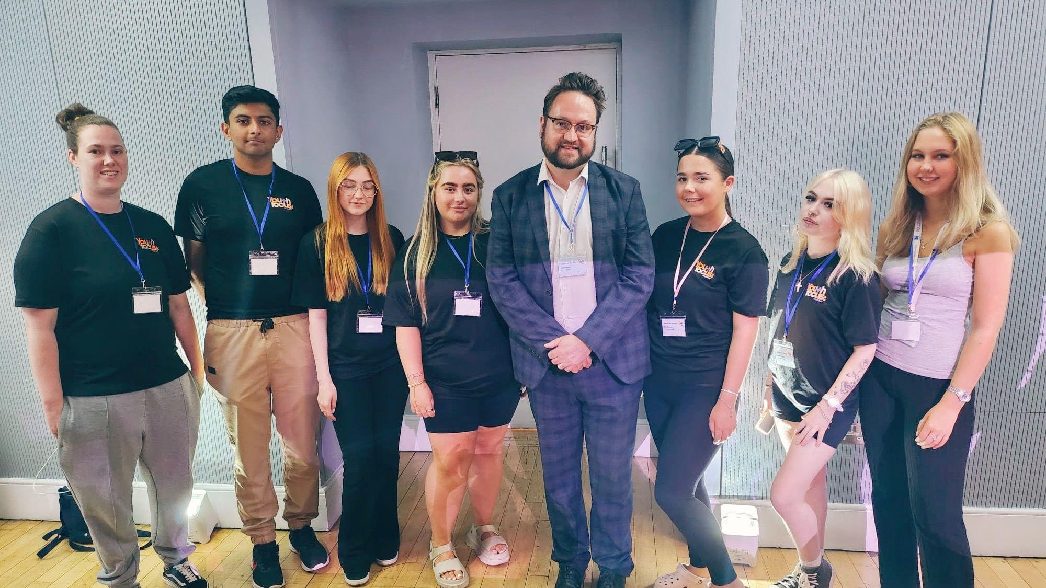
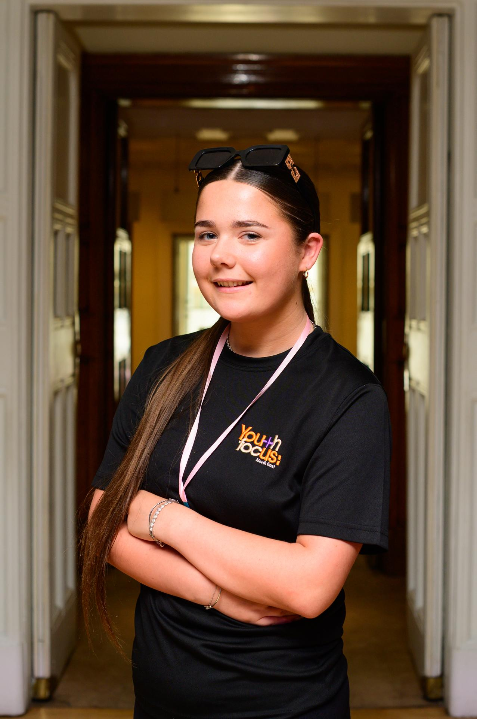
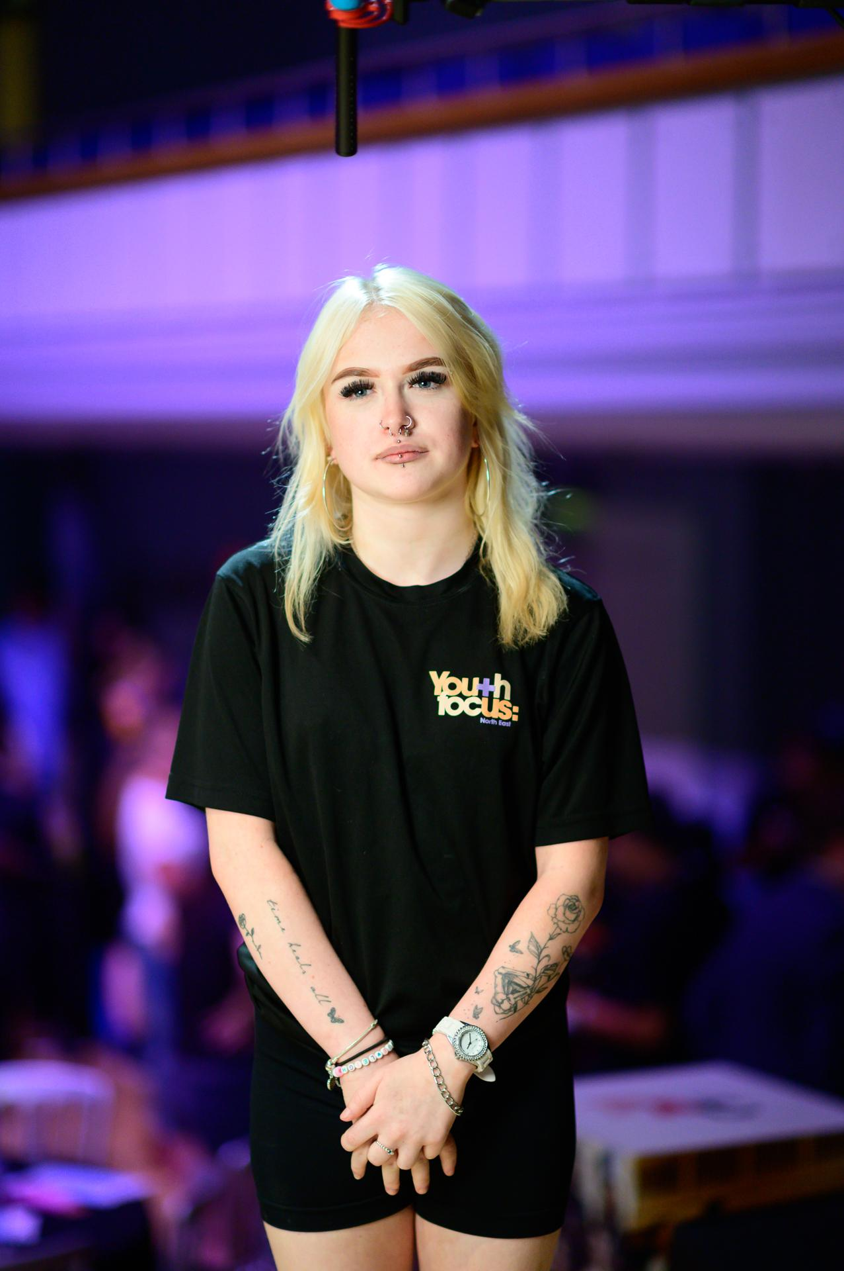
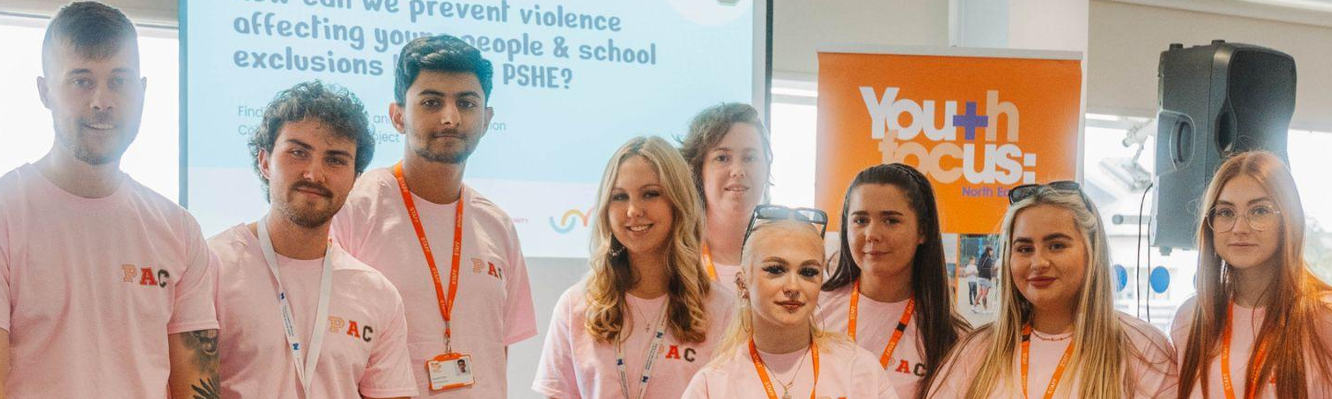
D.U.R.S model - Why it was created
“we have it [informal education] every week, vs , “I’ve never had it” shows the inconsistency across schools.
“Young people don’t want to be seen as a problem, they want to be part of the solution”
“We want people who are relatable”
“We want you to be curious, ask us why we feel certain ways and help us work through our thoughts and feelings. That is where you will see real change”
The young people emphasised that delivery is just as important as the content that is taught. They said they want “fun, engaging and interactive lessons, not just reading off a script”
Notes:
Jess

Slide 17

D.U.R.S model
D
Delivery
Young people told us that what is taught is just as important as how it is taught.
Delivery
-
Notes:
Jess

Slide 18

D.U.R.S model
U
Understanding
Truly understanding and acting upon the young person's wants and needs.
Understanding
-
Notes:
Jess

Slide 19
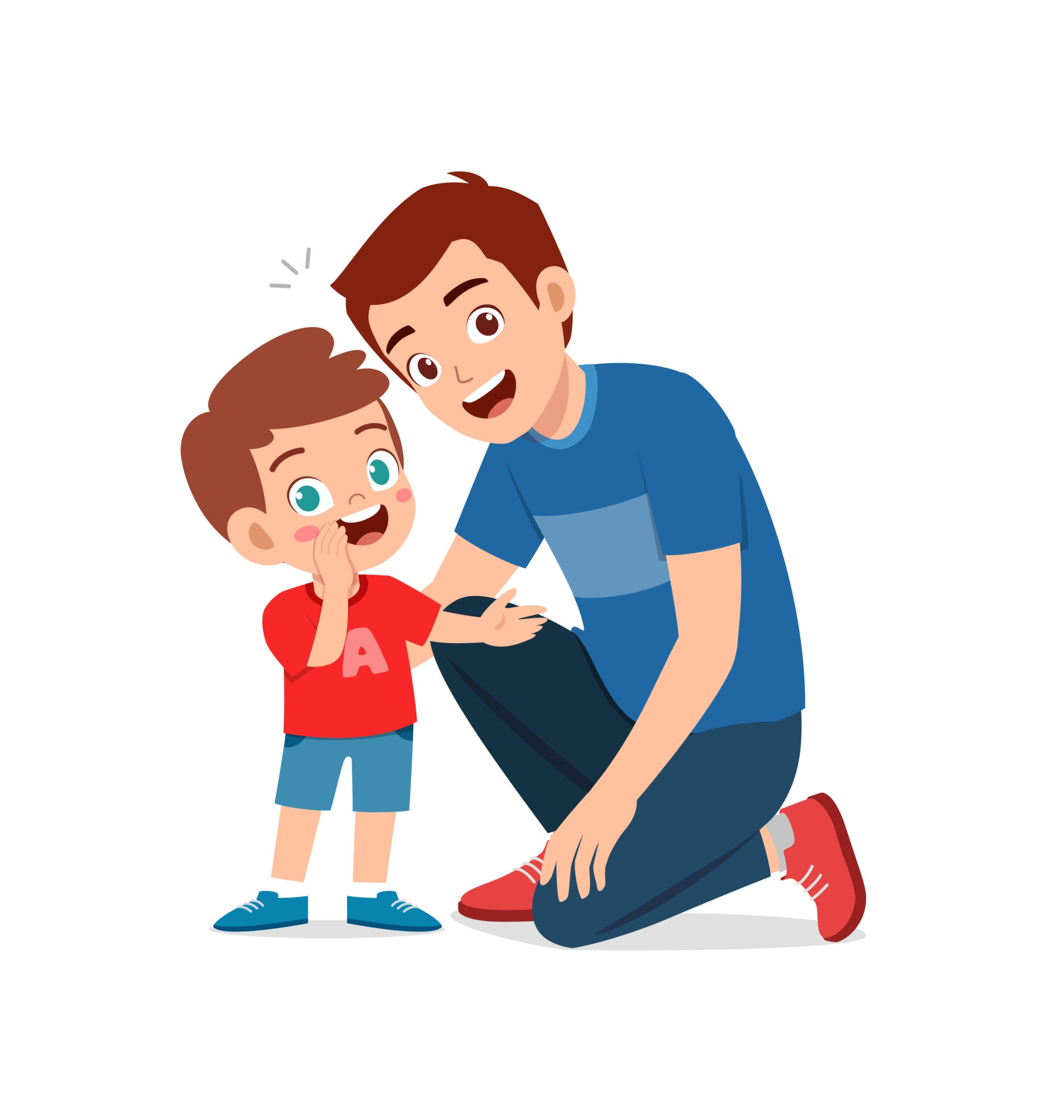
D.U.R.S model
R
Relationships
Positive, meaningful relationships are fundamental in order to build trust with young people.
Relationships
-
Notes:
Jess

Slide 20

D.U.R.S model
S
Support
Young people need more efficient, consistent and proactive support from adults around them.
Support
-
Notes:
Jess

Slide 21
D.U.R.S - in your practice
Reflection Activity -
Thinking about the work you do with young people, which part of the D.U.R.S model do you find the hardest to do, and why?
Notes:
Jess

Slide 22
Skills for Meaningful Youth Voice
Communication skills
Be open and honest
Show your respect
Adjust your voices tone and volume
Build trust
Notes:
Ava
Over the next few slides, we’ll be looking at the importance of the skills needed for meaningful youth voice. We’ll be focusing on why these matter. We will be speaking about creating safe spaces, being open and honest, showing respect, adjusting your tone and volume when communicating and building trust with young people.

Slide 23
Skills for Meaningful Youth Voice
Build trust
Benefits -
It gives the young person a sense of security
It promotes healthy and secure attachments
It improves young people’s mental health
Notes:
Ava
Building trust is key for meaningful youth engagement. If the young people do not trust you, they will not feel safe enough to be open and honest during your work with them.
I will be speaking through only some of the benefits of building trust with young people.
When trust is there, young people feel more secure and comfortable in the space they’re in.
It helps them build healthy, secure relationships with the adults around them, where they feel supported and understood.
Over time, that kind of trust can really make a difference to their mental health and overall wellbeing.

Slide 24
Skills for Meaningful Youth Voice
Be open and honest
Benefits -
Stronger and more trusting relationships
Better communication with young people
Improved and protected safeguarding
Encourages positive behaviour and decision making
Models healthy adult behaviour.
Notes:
Jess

Slide 25
Skills for Meaningful Youth Voice
Adjust your tone and volume
Benefits -
Builds trusting, positive relationships
Reduces conflict and aggression through de-escalation
Encourages young people to communicate openly
Supports emotional regulation
Creates a safe environment
Models healthy communication skills
Notes:
Jess

Slide 26
Skills for Meaningful Youth Voice
Show respect
Benefits -
Builds trust
Encourages engagement and participation
Creates a safe space
Young people can explore their identity
Allows them to develop key life skills
Promotes equality and inclusion
Notes:
Jess

Slide 27
How to show respect
SOLER theory, Gerald Egan (1986)
S
Squarely face the person
Shows you are giving them your full attention and that what they are saying matters.
O
Open posture
Signals that you are approachable and not judging them.
L
Lean slightly forward
Shows interest and encourages them to share their thoughts.
E
Eye contact
Helps them feel seen, valued and listened to.
R
Relax
Creates a calm, safe atmosphere so they feel comfortable talking to you
Notes:
Ava
This slide is about a really simple way we can show respect to young people through our body language and how we listen. It comes from the SOLER model by Gerald Egan, and it’s a helpful reminder that communication is about a lot more than just the words we use.
S – Squarely face the person
Just turning towards someone and giving them your attention can make a big difference. It helps show that you’re really with them in the conversation and that what they’re saying matters.
O – Open posture
If we’re closed off or distracted, it can make it harder for someone to feel comfortable. Keeping an open posture helps young people feel more at ease and more willing to talk.
L – Lean slightly forward
This is a small thing, but it shows interest. It lets the young person know you’re engaged and listening without crowding their space.
E – Eye contact
Appropriate eye contact helps people feel acknowledged and heard. It can really change how respected and understood someone feels in a conversation.
R – Relax
When we stay calm and relaxed, it helps create a more comfortable atmosphere where young people can speak more openly and honestly.
Put simply, SOLER is just a useful reminder that respect isn’t only shown through what we say, but through how we are with someone in the moment.

Slide 28

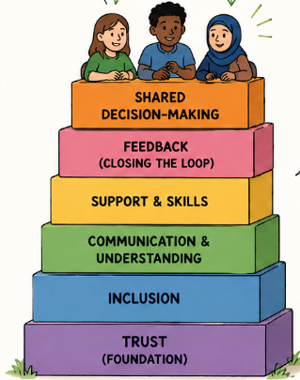
Principles that underpin Youth Voice
1 - Trust
Young people feel listened to, safe and respected
2 - Inclusion
Everyone has the opportunity to be involved and valued.
3 - Communication & Understanding
Information is clear and young people understand the project
4 - Support & Skills
Young people are supported to build confidence and life skills
5 - Feedback (closing the loop)
Young people are told what changed, what didn’t and why
6 - Shared decision-making
Young people have real influence and share power
Notes:
Jess

Slide 29
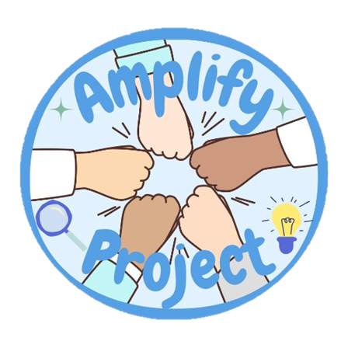
As a group, answer these questions:
What would happen to the young people if the blocks were added too quickly?
Think of some examples of when professionals may add the blocks too quickly
Breakout rooms
How can you avoid adding the blocks too quickly?
Notes:
Jess

Slide 30
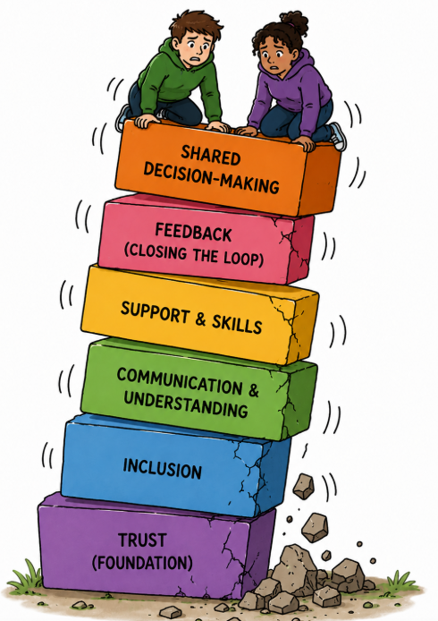

Principles that underpin Youth Voice
What happens?
The young people feel pressured, overwhelmed and will withdraw
The young people don’t understand enough to authentically contribute
Participation becomes tokenistic
Trust is damaged
Young people will not have any power
Notes:
Ava
As many of you have already spoke about during the breakout rooms feedback, if we try to move too quickly into the higher levels of youth voice without getting the foundations right, it can create real challenges.
When trust isn’t properly in place, young people can start to feel pressured or overwhelmed, and instead of engaging, they may begin to withdraw.
They might also not have enough clarity or understanding to contribute in a meaningful way, which can lead to participation feeling quite tokenistic.
Over time, that can damage trust rather than build it, and young people may end up feeling like they don’t really have any power or influence in what’s happening.
It’s a good reminder that taking time to build those early foundations properly really matters.

Slide 31


Principles that underpin Youth Voice
Key Message
Build the foundations. Take time. Support the young people. Listen. Act. Give Feedback.
Then add the next block. Step by step, we build real youth voice that is authentic and lasts!
“When we build it together, we create change together!”
Notes:
Ava
The key message to remember is build the foundations, take time, support the young people, listen, act, give feedback and then move onto the next block. Step by step we build real youth voice that is authentic and lasts.

Slide 32

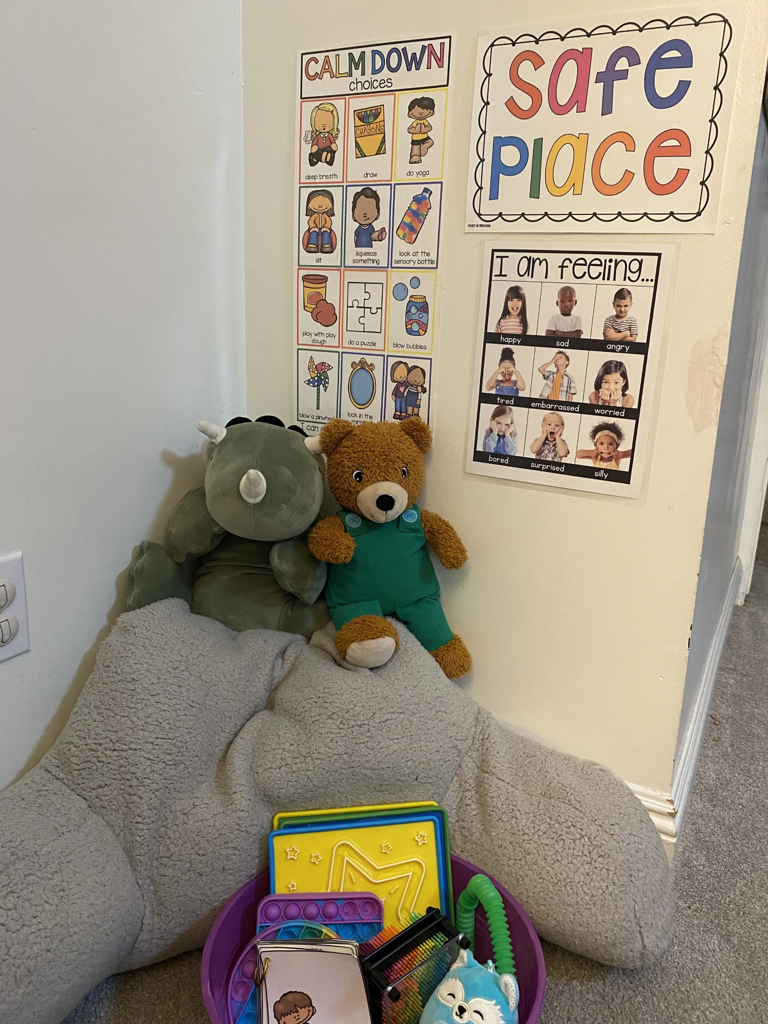
Safe Space
Definition -
An environment where people can feel secure and free from bias, conflict, criticism, or any form of emotional or physical harm.
It is a place where people can express themselves without fear of discrimination or negative judgement.
Notes:
Jess

Slide 33
Safe Space
Benefits
Able to express emotionally
Sense of community and belonging
Accessible mental health support
Empowerment
Reduced risk of anti-social behaviour
Behavioural interventions
Notes:
Jess

Slide 34
Safe Space
How to create a safe space with young people
Allow the young people to design the room and pick the items to go inside
Bring activities and fidget toys
Have drinks and snacks available
Have an adult in the room for the young people to speak to. They should be mental health, challenging behaviour and youth work trained.
Make it optional, this reduces pressure to go there
Remember that it is the young people’s space
Notes:
Jess

Slide 35
Ice Breakers
Definition -
A fun activity that is used to encourage a group of participants to interact with each other on an equal footing.
Benefits
Helps people to feel relaxed and comfortable
Encourages communication and interaction
Helps participants get to know each other
Creates a positive, welcoming environment
Makes sessions more engaging
Supports relationship building
Begins the formation of trust
Notes:
Ava
As I’m sure you all know, ice breakers are simple activities designed to help a group of participants feel more at ease at the start of a session. They can help people feel more relaxed and comfortable in the space, especially if they don’t know each other well.
Overall, they create a more positive and welcoming environment, which makes sessions more engaging and supports relationship building. Most importantly, they can also be the first step in beginning to build trust within a group - which as we have already seen is the foundation to successful youth voice.

Slide 36

Ice Breakers
How to make them effective
Last no longer than 10 minutes
Includes all members
Appropriate for your group
Clear instructions and demonstrations
Adaptable to groups needs
Link it to the session topic where possible
Notes:
Ava
To make ice breakers effective, just make sure they
Last no longer than 10 minutes
Include all members
Are appropriate for the group
Have clear instructions and demonstrations
Are adaptable to your groups needs
And link to the session topic where possible

Slide 37
Amplify: Regional voices in practice
Ice breaker toolkit talk through
Notes:
Ava
We’ve also put together a toolkit for everyone attending the training, which includes a range of ice breaker ideas. These have been co-designed with young people as part of the Amplify programme.
They’re practical, flexible, and ready to use, whether you’re starting a first session with a new group or working with an established group that already knows each other.
The activities are also organised by how much time they take, so it’s easy to pick something that fits the space you have.
PR note- share the screen and talk through the different sections of the toolkit

Slide 38
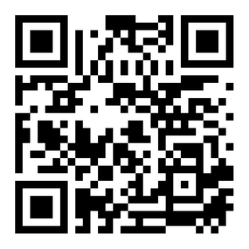
Ice Breakers
Toolkit
Scan here to receive a toolkit that we have created with examples of online and face to face icebreaker activities that you can use.
Notes:
Ava
Please feel free to scan the QR code to access the resource we have just shown.
I’ll give you all a second to do that before we move on.

Slide 39

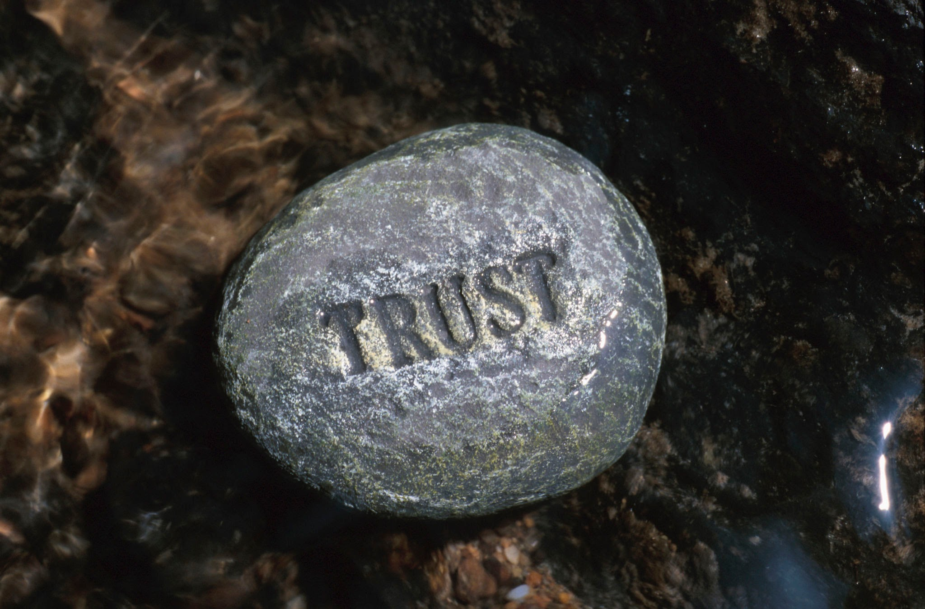
Trusted Adults
“ A trusted adult is chosen by the young person as a safe figure that listens without judgement, agenda or expectation, but with the sole purpose of supporting and encouraging positivity within a young person's life”
Young Minds 2022
Notes:
Jess

Slide 40
Trusted Adults
Mentors
Youth Workers
Family Friends
Family members
Pastoral staff
Who could be a trusted adult?
Teachers
Nurse
Therapists
Sports coach
Doctors
Parents
School councillors
Neighbours
Carers
Police
People in their place of worship
Notes:
Jess

Slide 41

Trusted Adults
How do I become one?
Build trust over time through actions, not just words
Be consistent and reliable
Listen without judging or interrupting
Follow through with what you say
Be honest and clear
Explain safeguarding limits and stick to them
Show empathy and understanding
Stay calm and approachable
Respect them
Be patient
Support them
Be positive and encouraging
Take them seriously
Value their experiences
Notes:
Jess

Slide 42
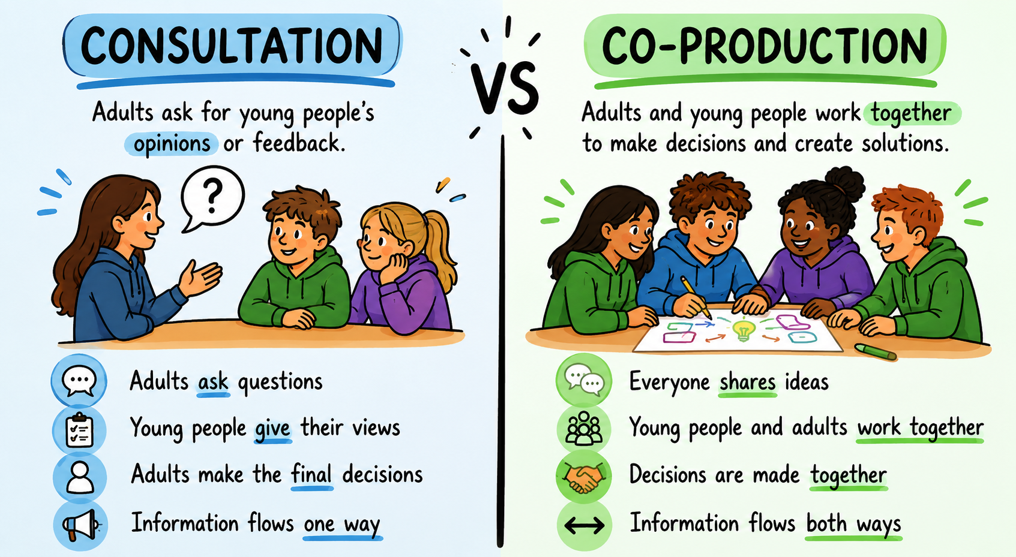
From Consultation to Co-Production
Notes:
Ava
We are now going to go through the difference between consultation and co-production.
Consultation is where young people are asked for their views, but the decision-making still sits elsewhere. Their input is gathered, but it may or may not directly shape what happens next. The young people are the only people giving the information, the adult receives and takes away the information
Co-production goes further than that. It involves young people as equal partners in the process, where they are actively involved in shaping, designing, and making decisions alongside professionals.
I’m now going to hand over to Jess who will explain a little bit more about what coproduction looks like in practice

Slide 43
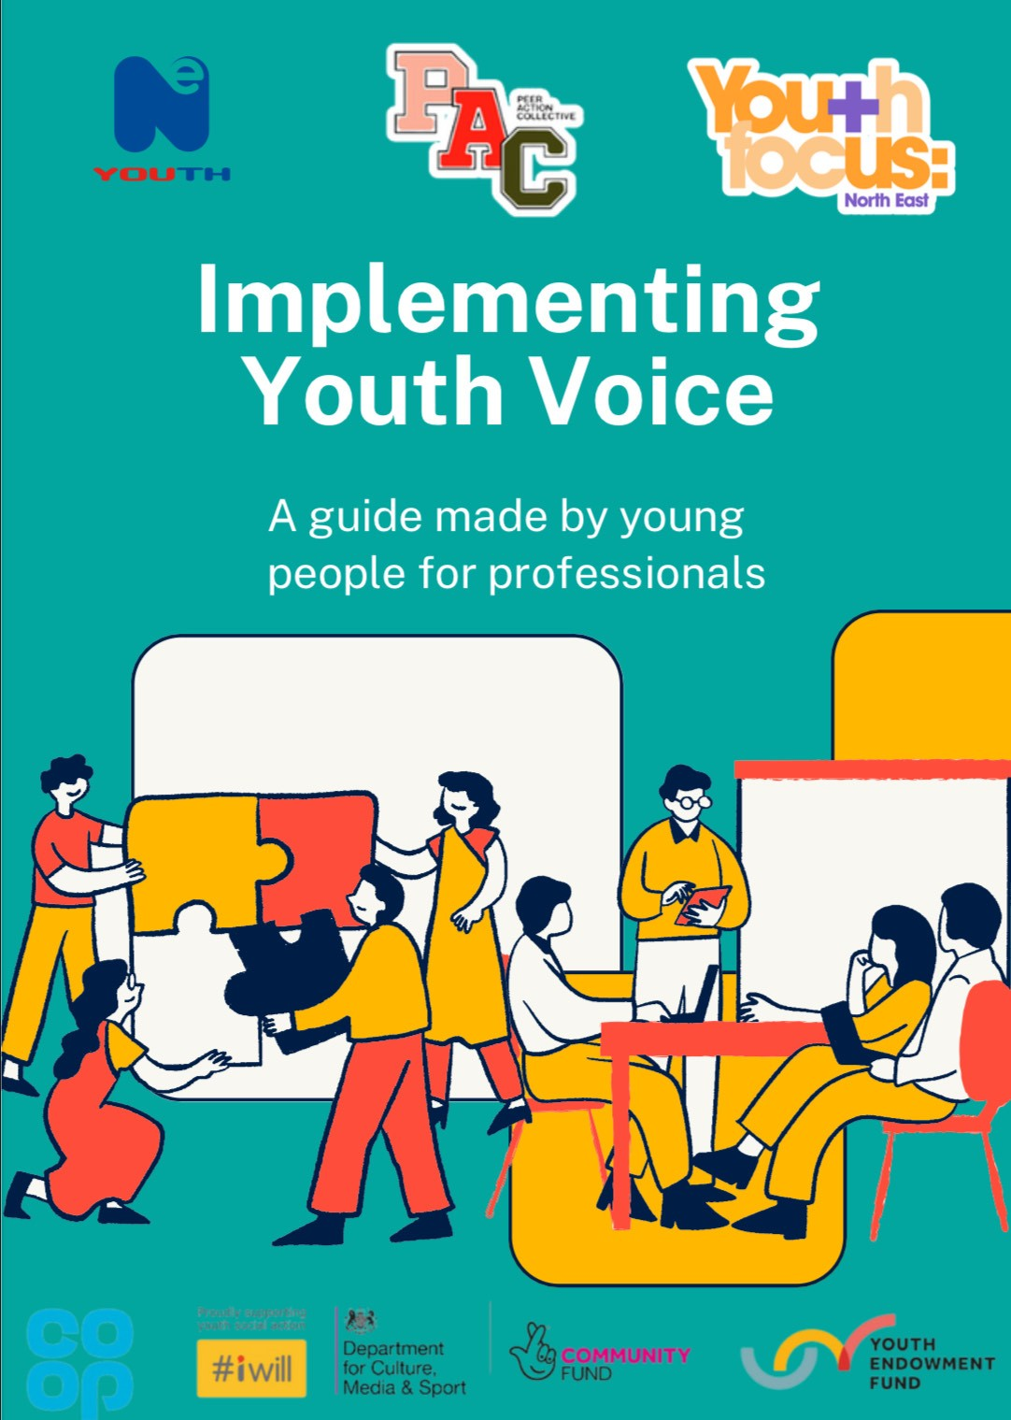

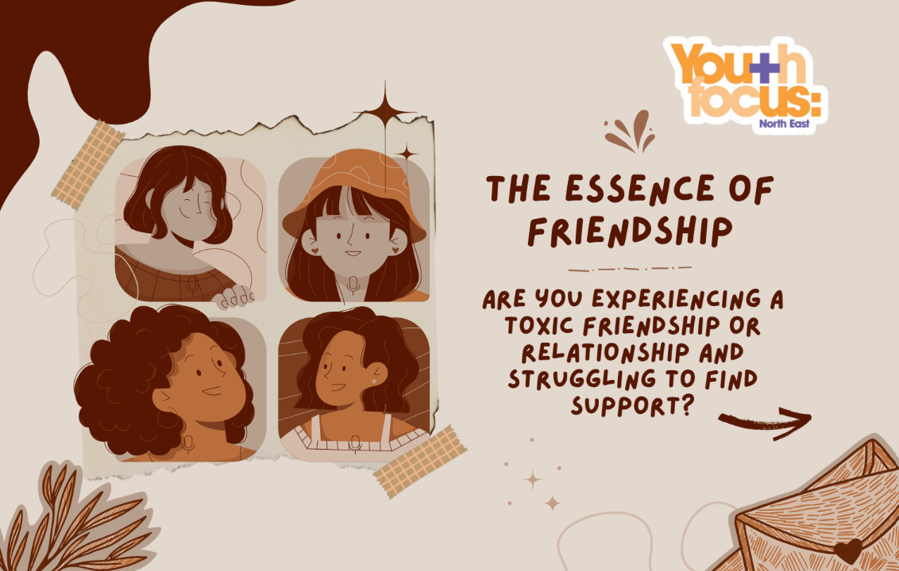


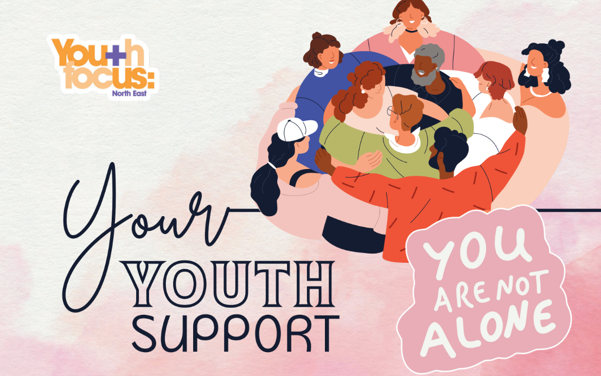
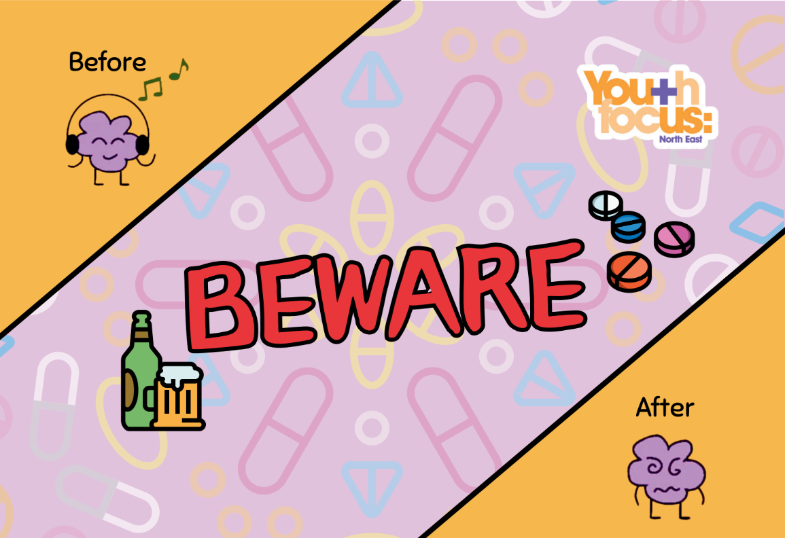
Co-Production in Practice
Peer Action Collective (PAC)
Young people were hired as Peer Researchers to design and conduct research based on serious youth violence
Research was conducted with activities with young people
Participants reviewed our research findings and picked up on things that we missed
Participants and other young people (changemakers) designed our social action outputs based off the findings
The changemakers reviewed the social action outputs with young people who weren’t previously involved
Changemakers were invited to our final showcase event, had the chance to speak to stakeholders about the outputs and were awarded for their hard work.
Notes:
Jess

Slide 44
Co-Production
Services become more relevant to young people’s needs
Benefits of co-production
Reduces tokenistic practice by sharing power
Young people feel valued, heard and respected
Builds stronger trust between staff and young people
Improves attendance and long term involvement
Helps organisations make better decisions
Encourages meaningful engagement and participation
More funding opportunities by showing genuine youth voice
Strengthens the organisations reputation and credibility
Creates more sustainable and effective projects and services
Notes:
Ava
Here are some of the many benefits of co producing projects with young people, including but not limited to creating more sustainable and effective projects and services, improving attendance and long term involvement as well as making young people feel heard, valued and respected.

Slide 45

Summary
Youth voice; what it is and how to properly embed this into your organisation
Theory of youth work
Tokenistic practice; how to avoid this with examples
D.U.R.S framework and how to use this with examples
Skills including ; communication, trust, safe spaces, trusted adults and key principles
Ice breakers
Moving from consultation to co-production
Notes:
Ava
We’re now coming to the end of our training session.
Today we’ve explored a range of approaches that support the successful implementation of youth voice. We started with ice breakers, looking at why they matter and what effective practice looks like both online and face to face.
We then moved into youth voice itself, including what it means in practice, what good examples look like and how to avoid tokenistic approaches.
We also introduced our D.U.R.S model, how it was developed, and how it can be applied in real settings. Alongside this, we looked at key skills for working with young people and the theory that underpins them.
We discussed the importance of the core principles of youth voice, including trusted adults and the role they play in building strong, supportive relationships. We also explored safe spaces and how these can be designed with young people so that everyone feels included.
Finally, we looked at the difference between consultation and co-production and why moving towards shared decision-making is so important.
Hopefully this has given you some practical tools and a clearer understanding of how youth voice can be implemented in a meaningful way.

Slide 46
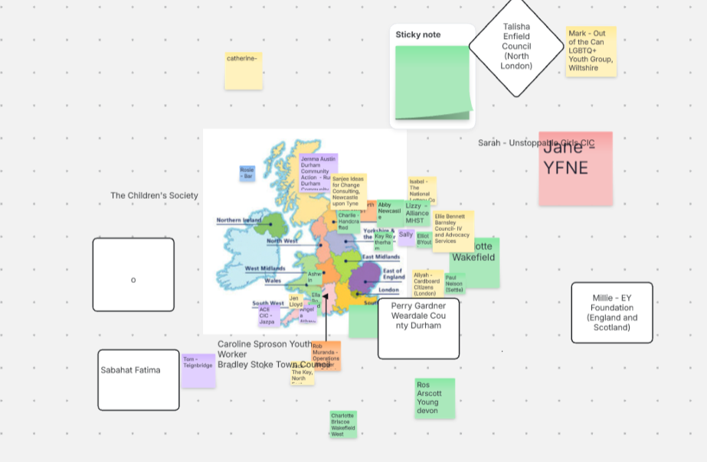
Who is in the room with us?
Notes:
Ava - As you can see by the map shown on screen, there are people from all different areas that have joined today. It is amazing to see so many people wanting to be a part of this training and wanting to learn how to embed youth voice properly.

Slide 47

Feedback
We would love to hear from you:
  What worked well?
  What were any challenges faced?
  How could you use this with young people?
Evaluation forms will be shared in the chat, please take 2 minutes to complete. Thank you!
Notes:
Ava - Link https://docs.google.com/forms/d/e/1FAIpQLSf5RHIJtVIEFRcuSJtufsHxSiUQe_XZxa1BTgxQsBslBFx6Rg/viewform?usp=header
Thank you very much for attending today, we hope it has been informative and you can walk away with a better understanding of how to meaningfully embed youth voice in your organisation.
We are now wanting to gain feedback from you about what you think went well in this training and what could be improved. Your feedback will help us develop future training sessions and it is much appreciated.
Please click the link in the chat box and fill out the evaluation form!

Slide 48
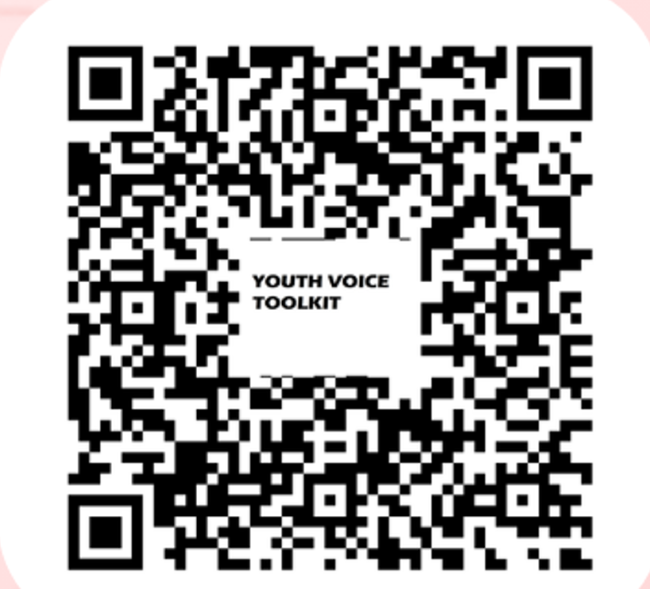
Implementing Youth Voice Toolkit
Notes:
Ava
If you would like to have access to the Implementing Youth Voice toolkit that this training session was based off, please scan the QR code on the screen!

Slide 49

Thank you to our partners
Notes:
Jess Thank you to all our partners who are a part of the Regional Youth Units
and Thank you to our Funder the National Lotteries Community Fund.

